Slide 1
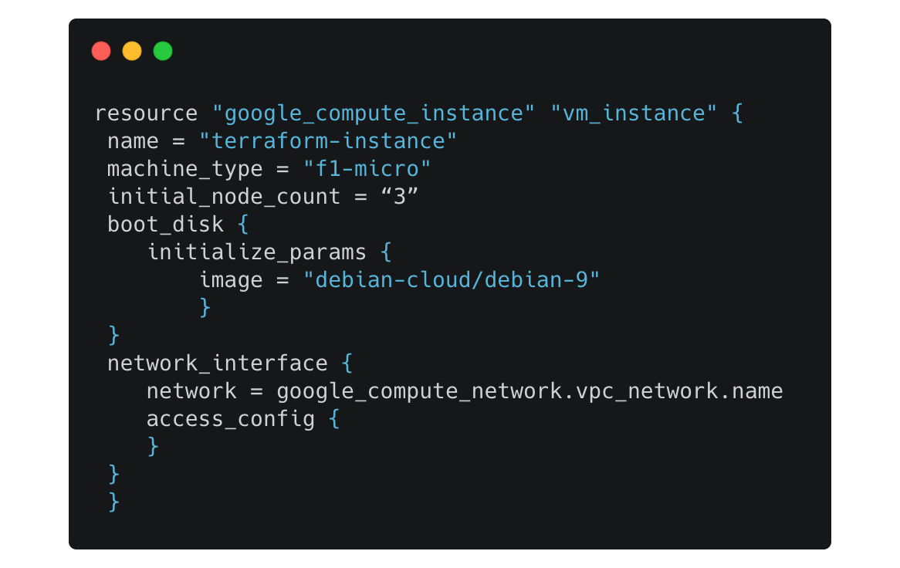
What is IaC?
Script your infrastructure

Slide 2
Why Terraform?
Cloud Platform independent
Best for Hybrid Cloud environment
Easy to install and configure: Demo shortly in this video
Can be written in JSON or YAML
Large active community for support

Slide 3
Installation Demo
Install and configure AWS CLI
Installation commands from documentation

Slide 4
Deploy an AWS EC2 Instance with Terraform
provider.tf
terraform {
required_providers {
aws = {
source = "hashicorp/aws"
version = "5.59.0"
}
}
}
provider "aws" {
region = "us-east-1"
}
main.tf
resource "aws_instance" "this" {
ami = "ami-0a0e5d9c7acc336f1"
key_name = "linuxdemokp"
instance_type = "t2.micro"
tags = {
Name = "techapricate"
}
}

